Slide 1

Customer Churn Prediction
Using Machine Learning Classifiers
By Model Masters

Slide 2

Introduction
What is churn?
Churn refers to when a customer stops doing business with a company.
Predicting churn helps businesses proactively retain customers.
Objective:
- Use machine learning to predict which customers are likely to churn.
- Provide actionable insights for retention strategies.

Slide 3

Agenda
Dataset Overview
Data cleaning and Feature Engineering
Key Feature Identification
Data Imbalance and Balancing Data
Model Development and Results
Feature Importance and Insights
Conclusion and Recommendations

Slide 4
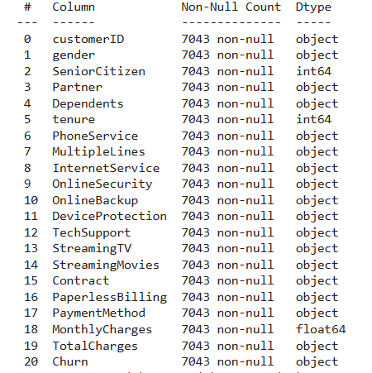
Dataset Overview
Dataset Size:
7043 rows and 21 columns.
Categorized Features:
1. Demographic Features:
- gender, seniorcitizen, partner, dependents
2. Service Features:
- phoneservice, multiplelines, internetservice, onlinesecurity, onlinebackup, deviceprotection, techsupport, streamingtv, streamingmovies
3. Account Features:
- contract, paperlessbilling, paymentmethod, monthlycharges, totalcharges
4. Target Variable:
- churn

Slide 5
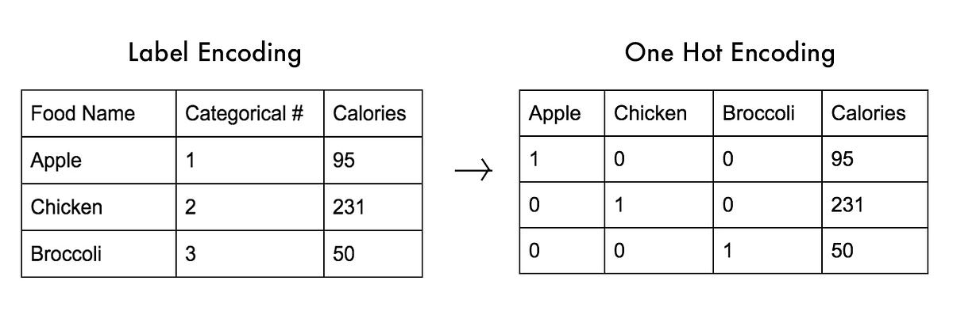
Data Cleaning and Feature Engineering
Steps Taken:
1. Removed Irrelevant Columns:
- Dropped customerID.
2. Handled Missing Values:
- Identified empty rows in dataset and removed them.
3. Dropped Duplicates:
- Ensured no duplicate rows for data integrity.
Encoding Categorical Variables:
One-hot encoding for multi-class features like contract and paymentmethod.
Label encoding for binary features like gender and partner.
Scaling Numerical Features:
Normalized monthlycharges and totalcharges to ensure equal importance during modeling.

Slide 6
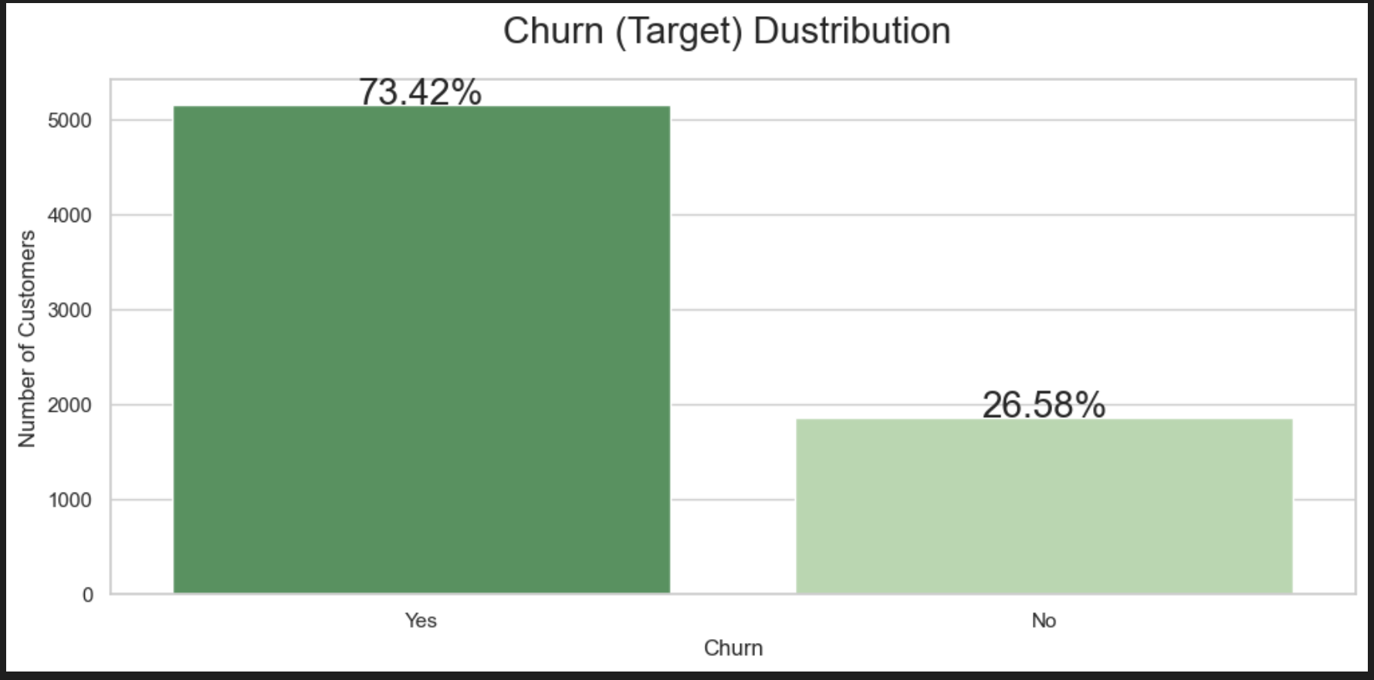
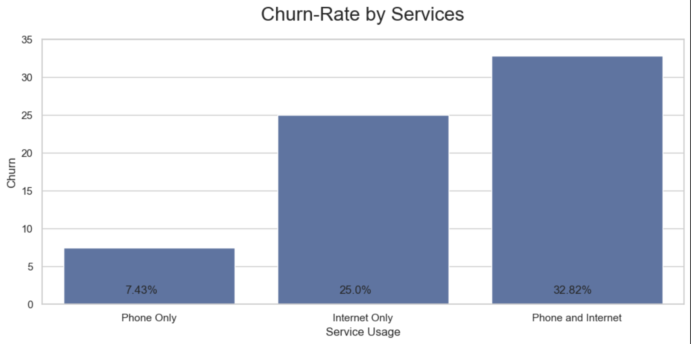
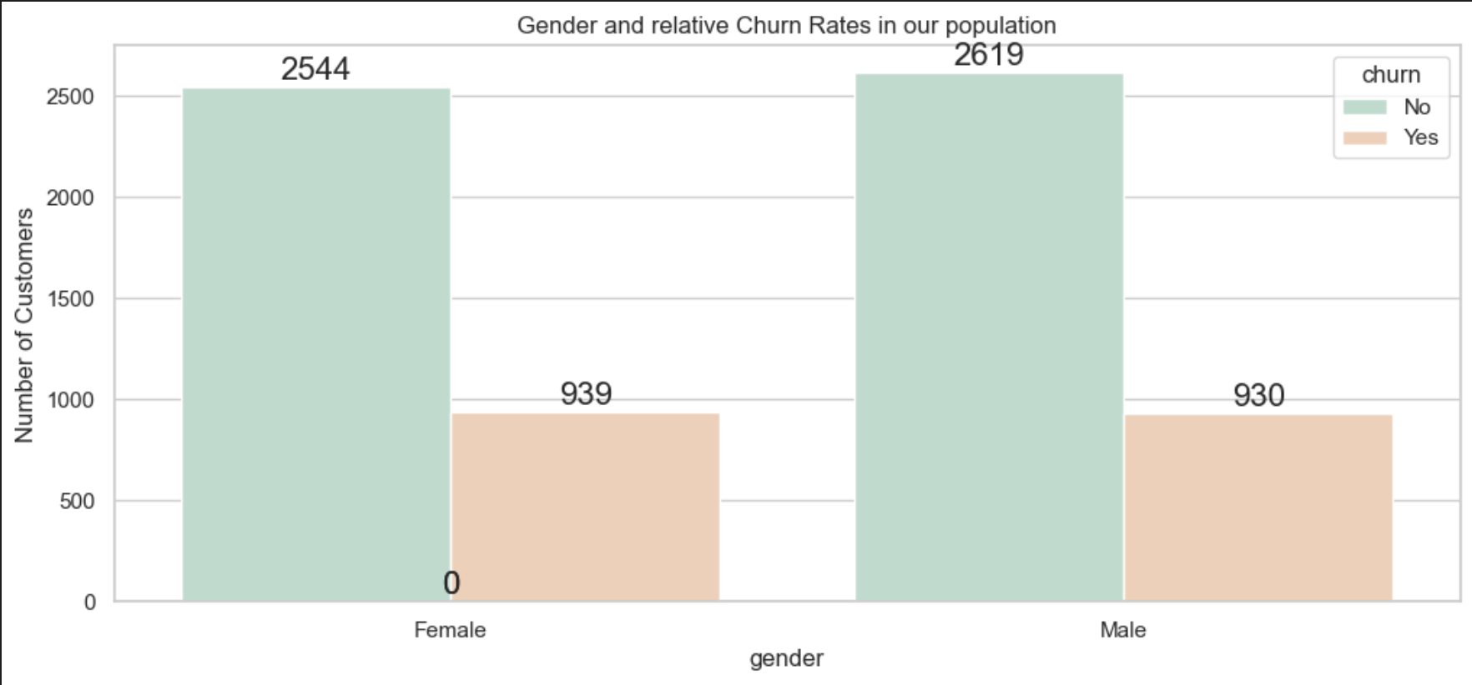
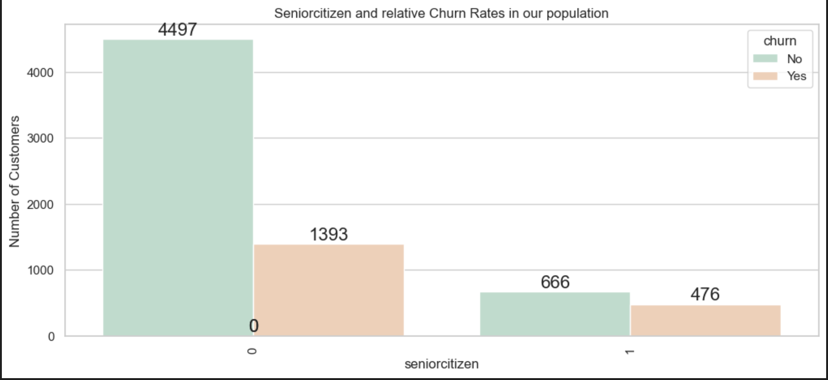
Initial Analysis of Features
Churn Target Distribution
Churn Rate by Services
Gender Churn Rates
Senior Citizen and Churn Rates

Slide 7
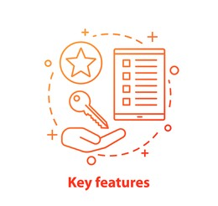
Identifying Key Features
1. Exploratory Data Analysis (EDA):
- Correlation Analysis: Compute correlation coefficients between features and the target variable (churn).
- Visualize correlations using a heatmap to identify strongly related features.
- Example: Features like tenure often show a strong correlation with churn.
2. Feature Importance :
- Train models like Adaboost and extract feature importance scores.
- Importance is based on how much a feature contributes to reducing prediction error.
- Manually create Bar plots to see which features are most influential on churn.
3. Domain Knowledge:
- Some features, like contract length or paymentmethod, are intuitively important because they directly relate to customer behavior.

Slide 8
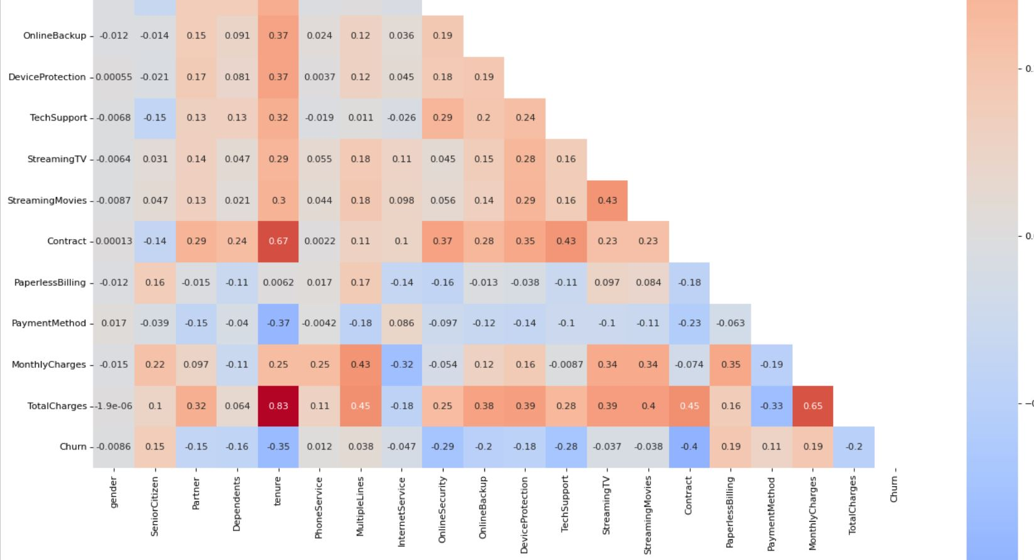
Correlation Heatmap

Slide 9
Balancing Data
Why It’s Problematic:
- Models prioritize overall accuracy, often ignoring minority classes.
- Results in poor recall, high false negatives, and biased decision boundaries.
Techniques to Handle Imbalanced Data:
1. Resampling Techniques:
- Undersampling: Reduces the majority class size.
- Advantage: Faster training, balanced dataset.
- Limitation: Potential loss of important majority-class information.
- Oversampling: Increases minority class size by duplicating samples.
- Advantage: No information loss.
- Limitation: Risk of overfitting due to repeated samples.
- SMOTE: Generates synthetic samples for the minority class.
- Advantage: Preserves data diversity and reduces overfitting.

Slide 10
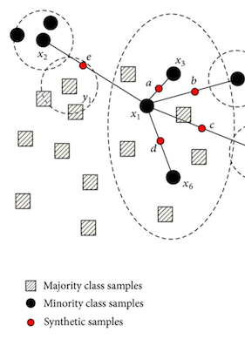
SMOTE
What is SMOTE?
- SMOTE (Synthetic Minority Oversampling Technique) generates synthetic samples to balance data instead of duplicating minority samples.
How SMOTE Works:
1. Select a sample from the minority class.
2. Identify its k-nearest neighbors in feature space.
3. Generate synthetic samples by interpolating between the sample and its neighbors.
Advantages:
- Avoids data loss (like undersampling).
- Reduces overfitting (unlike oversampling duplicates).
- Respects data distribution, ensuring synthetic samples are meaningful.

Slide 11

Machine Learning Models Used
SVM
Decision trees
Naive Bayes
Adaboost
Stacked model

Slide 12
Overview of Models (1)
1. Decision Tree: A tree-based algorithm that splits data into subsets based on feature values to make predictions.
Key Characteristics:
Easy to interpret and visualize.
Handles both categorical and numerical data effectively.
Accuracy Achieved: 73%
2. Support Vector Machine (SVM): SVM works by finding the hyperplane that best separates classes in a high-dimensional space.
Key Characteristics:
Uses kernel functions (e.g., linear, polynomial, RBF) to handle non-linear relationships.
Robust to outliers, especially when using a soft margin.
Accuracy Achieved: 75%

Slide 13
Overview of Models (2)
3. Naive Bayes: A probabilistic classifier based on Bayes' Theorem with the assumption of feature independence.
Key Characteristics:
Fast and computationally efficient.
Performs well with categorical and text data.
Accuracy 74%
4. AdaBoost (Adaptive Boosting): An ensemble learning method that combines weak classifiers (e.g., decision stumps) to form a strong classifier.
Key Characteristics:
Reduces bias and variance.
Works well with simple base models like decision trees.
Accuracy Achieved: 77%

Slide 14
Stacking Models for Improved Accuracy
What is Stacking?
Stacking is an ensemble learning technique where multiple models are combined to improve prediction accuracy.
It works by:
Training base models (e.g., AdaBoost and Naive Bayes) on the dataset.
Feeding their predictions into a meta-model (e.g., logistic regression) to make the final prediction.
Why It Works:
Combines the strengths of individual models.
Reduces the weaknesses of individual classifiers by leveraging complementary features.

Slide 15
Why AdaBoost and Naive Bayes?
AdaBoost:
Handles complex decision boundaries.
Focuses on misclassified samples, improving predictions for hard-to-classify instances.
Naive Bayes:
Works well with categorical features and assumes independence between predictors.
Computationally efficient, balancing AdaBoost’s complexity.
How They Work Together:
AdaBoost complements Naive Bayes by addressing its limitations, such as its assumption of feature independence.
Naive Bayes adds simplicity and speed to AdaBoost’s iterative weight adjustments.
Combined in stacking, their predictions achieved an accuracy of 80%, outperforming individual models.

Slide 16
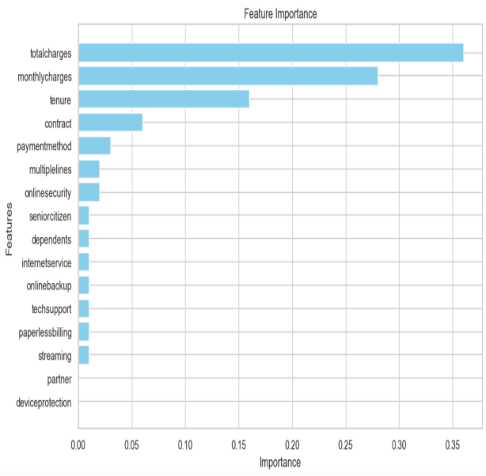
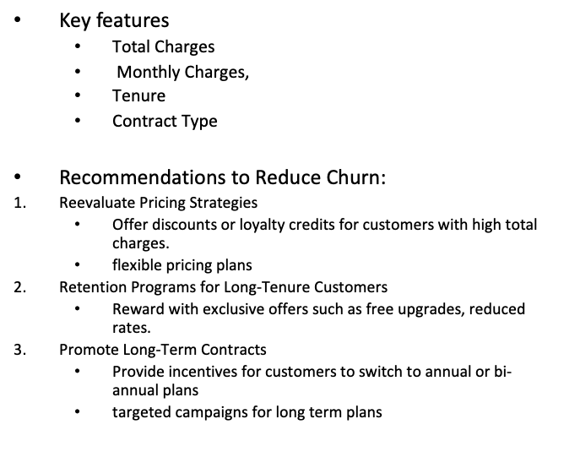
Insights and Recommendations for Telco

Slide 17
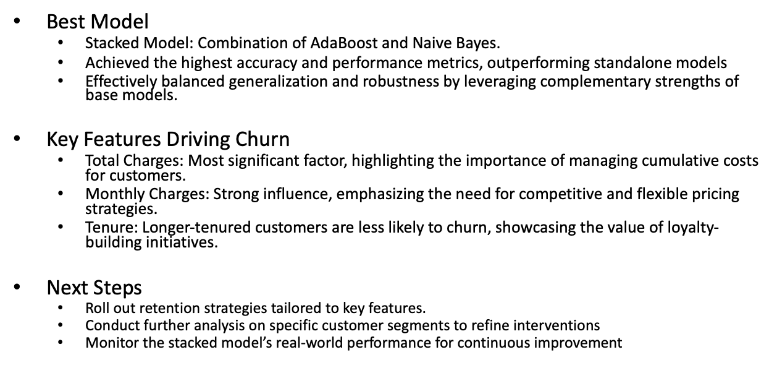
Conclusion and Key Takeaways

Slide 18

Thank you
Any Questions?

